Slide 1
SERVE AND SHOP
PROJECT MID TERM REVIEW – ECE 651
Prepared By – GROUP 17
Abhi Rajendra Zanzarukiya | 20892635
Heli Mistry | 20985952
Niravkumar Talaviya | 20896128
Shanthi Meena Arumugam | 20986268

Slide 2
APPLICATION OVERVIEW
Application to enable community-based purchase and delivery of items
Enables a P2P interaction amongst its people
Users can place orders in group(s), and a reliable member can serve his request at very nominal rates
Builds a solid trust-based community inclusion

Slide 3

TECH-STACK

Slide 4
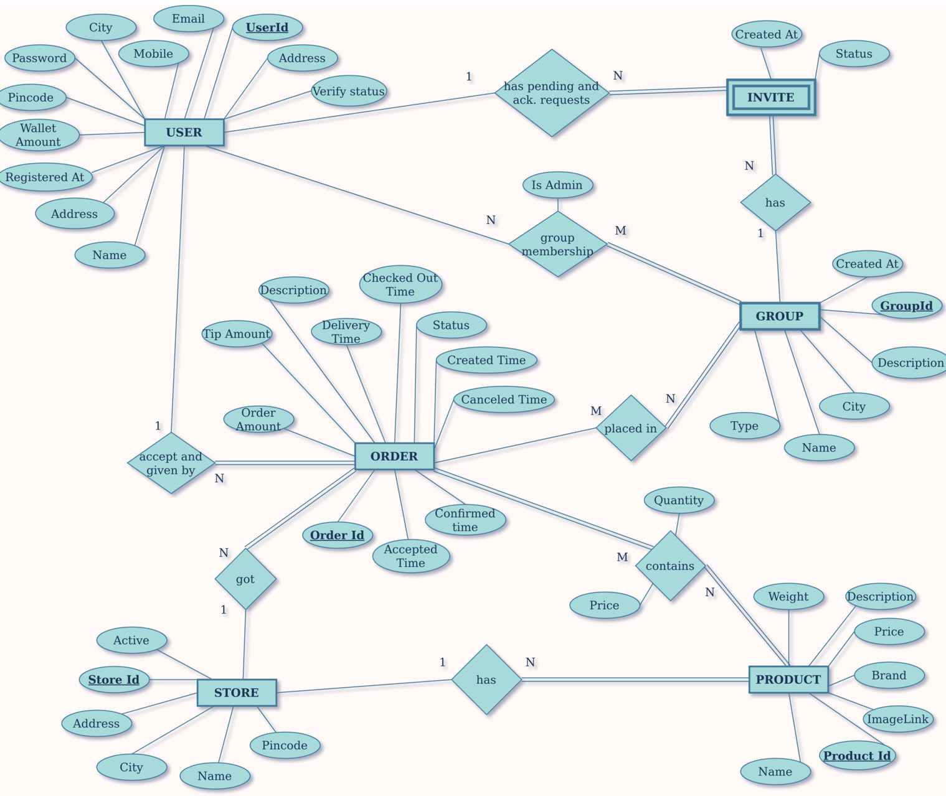
ER-Diagram

Slide 5
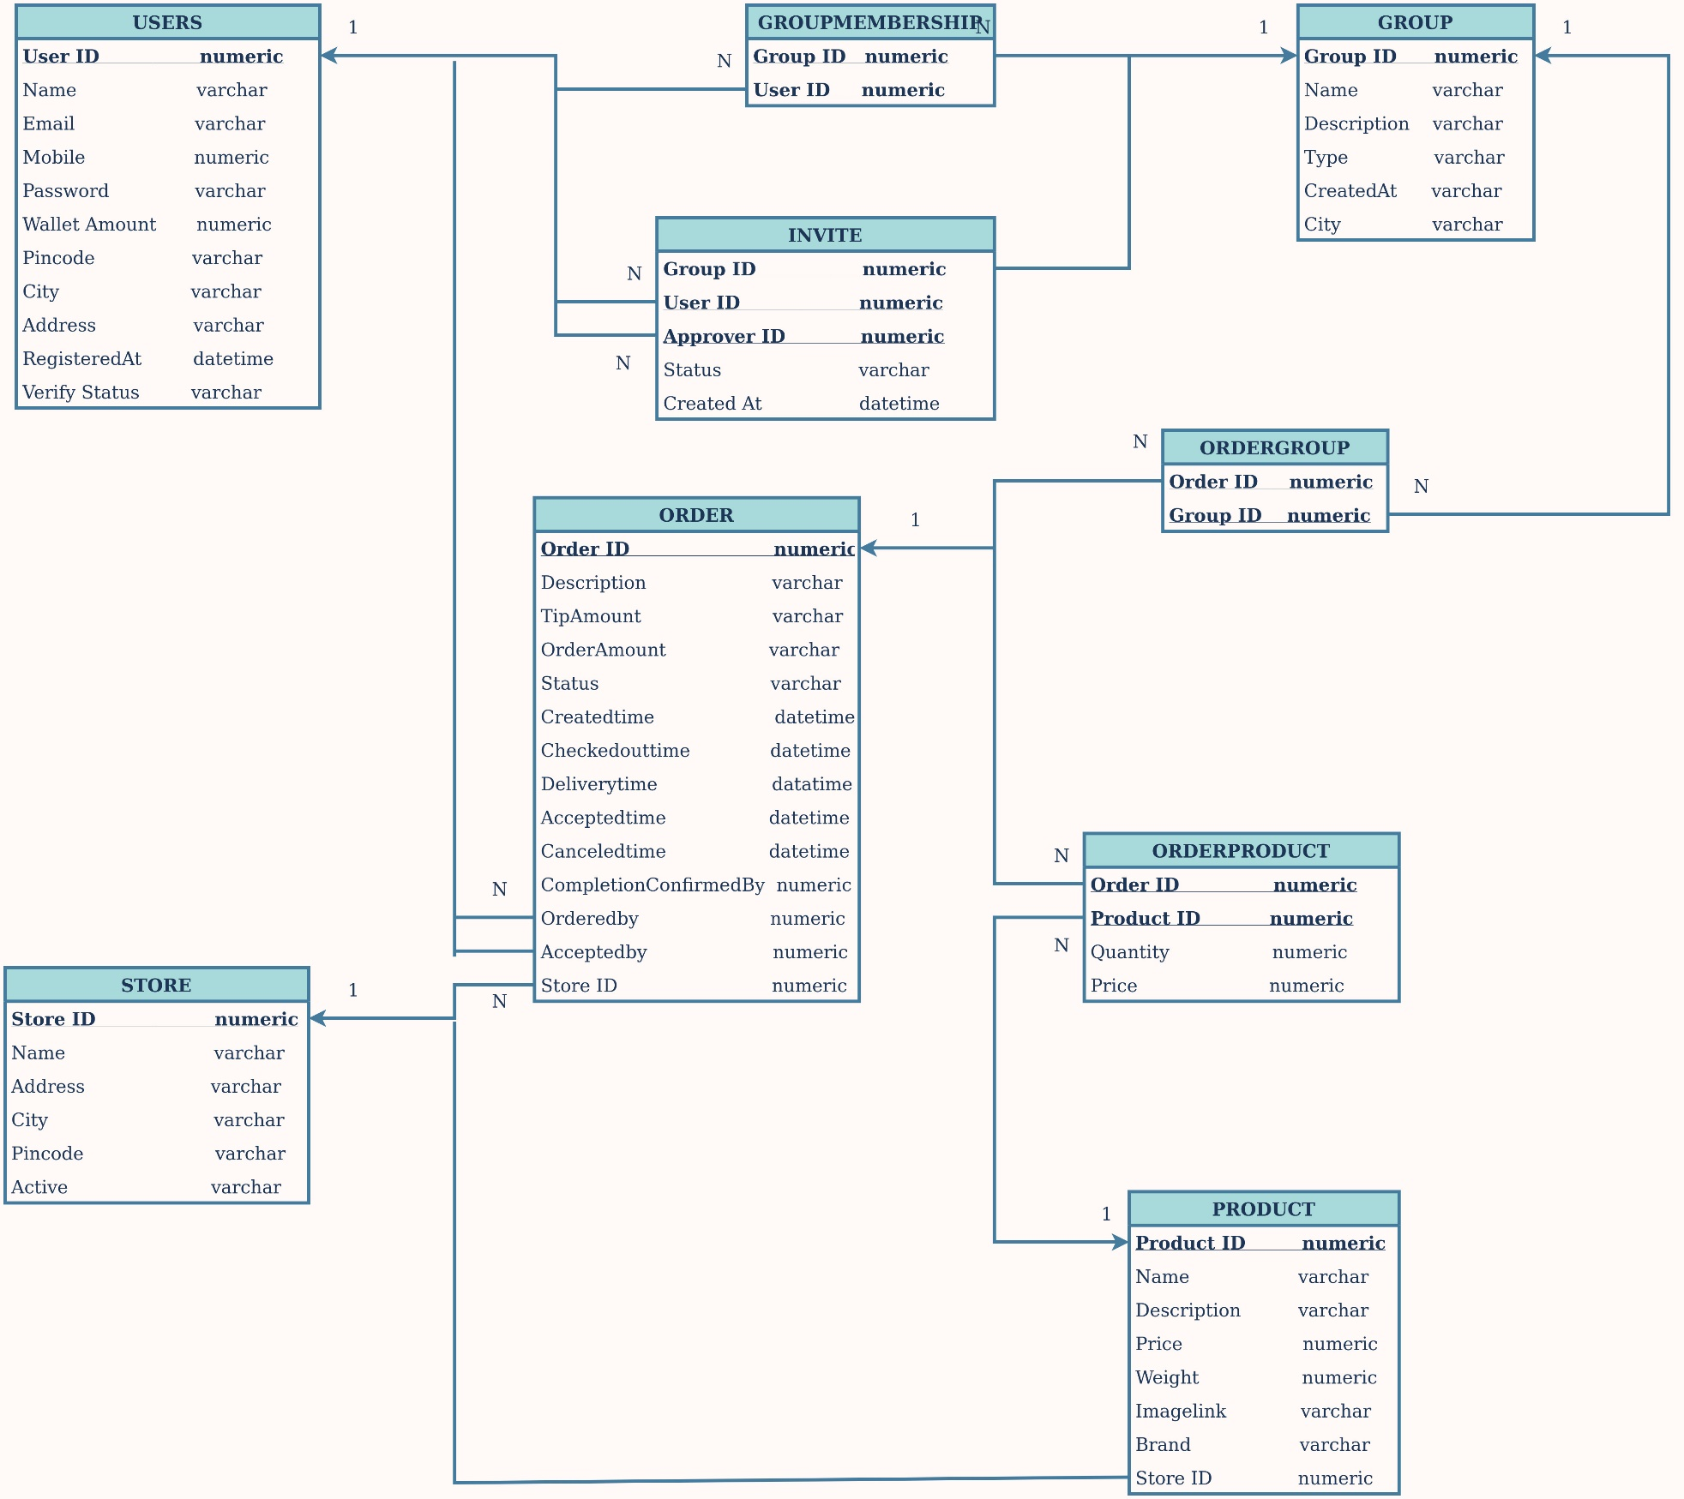
Class Diagram

Slide 6
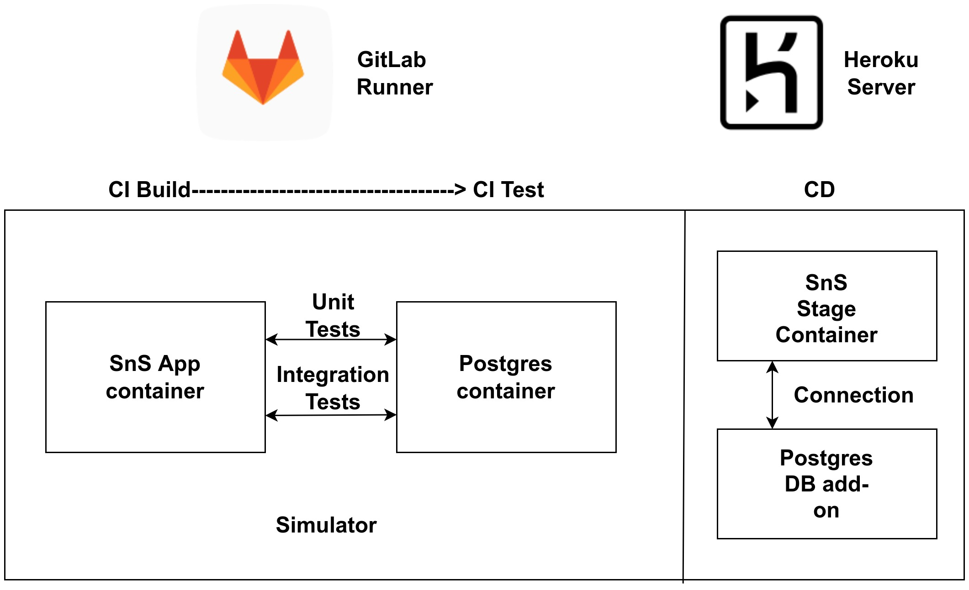
CI/CD

Slide 7
THANK YOU

